Slide 1
UNIT 3 -RADIATION HEAT TRANSFER PHENOMENA
Learning Objectives
After studying this unit you should be able to:
Distinguish between radiation and diffusion.
Define emissive power, black body, monochromatic emissive power and other terms that are specific to radiation heat transfer.
Understand wavelength dependent properties and define total hemispherical emissivity and absorptivity of surfaces.
Define radiative properties; emissivity, absorptivity, reflectivity and transmissivity of surfaces.

Slide 2
INTRODUCTION TO RADIATION HEAT TRANSFER
Radiation is propagated by electromagnetic waves. Electromagnetic waves are characterised by their frequency and wavelength , These two properties in a medium are related by
Where c is the speed of light in the medium. For propagation in a vacuum, c = c_{o} = 2.998 x 10⁸ m/s.
For air and most gases, n = 1, while for water and glass, n = 1.5 .
Unlike the wavelength and the speed of propagation, the frequency of an electromagnetic wave depends only on the source and is independent of the medium through which the wave travels.
Quantum theory
where h = 6.625 x 10⁻³⁴ J s is called the Planck’s constant.

Slide 3
Thermal Radiation
The type of electromagnetic radiation that is pertinent to heat transfer is thermal radiation. The rate of thermal radiation emission increases with increasing temperature.
Thermal radiation is also defined as the portion of the electromagnetic spectrum that extends from about 0.1 to 100 μm. Thus, thermal radiation includes the entire visible and infrared (IR) radiation as well as a portion of the ultraviolet (UV) radiation.
The wavelength ranges of different colours
COLOUR | WAVELENGTH BAND, μm
Violet | 0.40 – 0.44
Blue | 0.44 – 0.49
Green | 0.49 – 0.54
Yellow | 0.54 – 0.60
Orange | 0.60 – 0.63
Red | 0.63 – 0.76

Slide 4
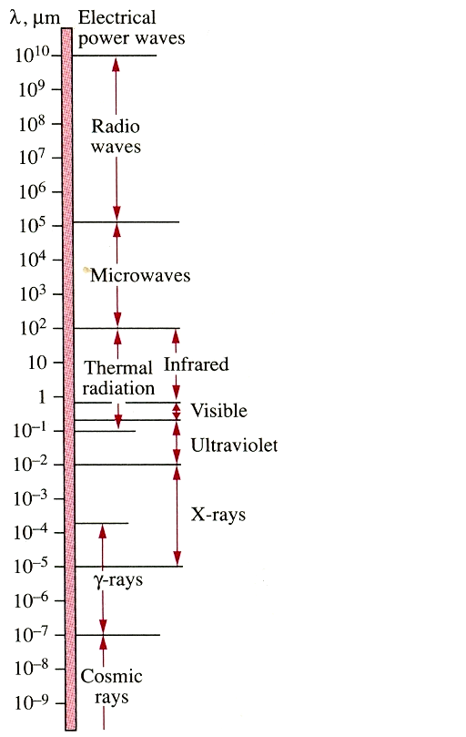
Thermal Radiation Contd
Figure-28 Electromagnetic Spectrum

Slide 5
THERMAL RADIATION CONTD
A body that emits some radiation in the visible range is called a light source. The electromagnetic radiation emitted by the sun is known as solar radiation, and nearly all of it falls into the wavelength band of 0.3 - 3 . Almost half of solar radiation is light, with the remaining being ultraviolet (0.01 – 0.40 ) and infrared (0.76 - 100 ).
Bodies at room temperature emit radiation in the infrared range, which extends from 0.76 to 100 μm.
Bodies start emitting noticeable visible radiation at temperatures above 800K.
The tungsten filament of a light bulb must be heated above 2000 K before it can emit any significant amount of radiation in the visible range.
In heat transfer studies; we are interested in the energy emitted by bodies because of their temperature only. Therefore, we shall limit ourselves to thermal radiation or simply radiation. Though radiation is a volumetric phenomenon, for opaque (non-transparent) solids such as metals, wood and rocks, radiation is considered to be a surface phenomenon.

Slide 6
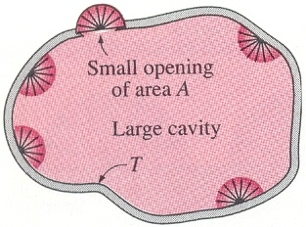
Black body Radiation
A blackbody is a perfect emitter and a perfect absorber of radiation. In addition, a blackbody emits radiation energy uniformly in all directions. As a result, a blackbody is often called a diffuse emitter. The terms diffuse means “independent of direction”.
The Stefan-Boltzmann law gives the total blackbody emissive power, which is the sum of the radiation emitted over all wavelengths.
The spectral (monochromatic) blackbody emissive power, which is the amount of radiation energy emitted by a blackbody at an absolute temperature T per unit time, per unit surface area, and per unit wavelength about the wavelength.
Figure 29: A large cavity with a small opening

Slide 7
Monochromatic emissive power
Monochromatic emissive power is defined as the amount of radiant energy emitted by a blackbody at an absolute temperature T per unit time, per unit surface area, per unit wavelength .
The monochromatic (spectral) blackbody emissive (W/m².μm) is expressed by the Planck’s distribution law according to the equation.
Note: The term spectrum indicates dependence on wavelength.
The radiant energy emitted by a blackbody per unit area over a wavelength band from 0 to λ is determined b integrating the equation for
blackbody radiation function
The function represents the fraction of radiation emitted from a blackbody at temperature T in the wavelength band 0 to λ

Slide 8
Monochromatic emissive power Cont’d
The values of are tabulated extensively in textbooks as a function of , and selected values are given in Table 6 below
Table 6: Blackbody radiation function
200 400 800 1000 1400 1800 2000 2600 2800 3000 3400 4000 | 0.000000 0.000000 0.000016 0.000321 0.007790 0.039341 0.066728 0.183120 0.227897 0.273232 0.361735 0.480877 | 4200 4400 4800 5000 5400 5800 6000 7000 8000 9000 10000 100000 | 0.516014 0.548796 0.607559 0.633747 0.680360 0.720158 0.737818 0.808109 0.856288 0.890029 0.914199 0.999905

Slide 9
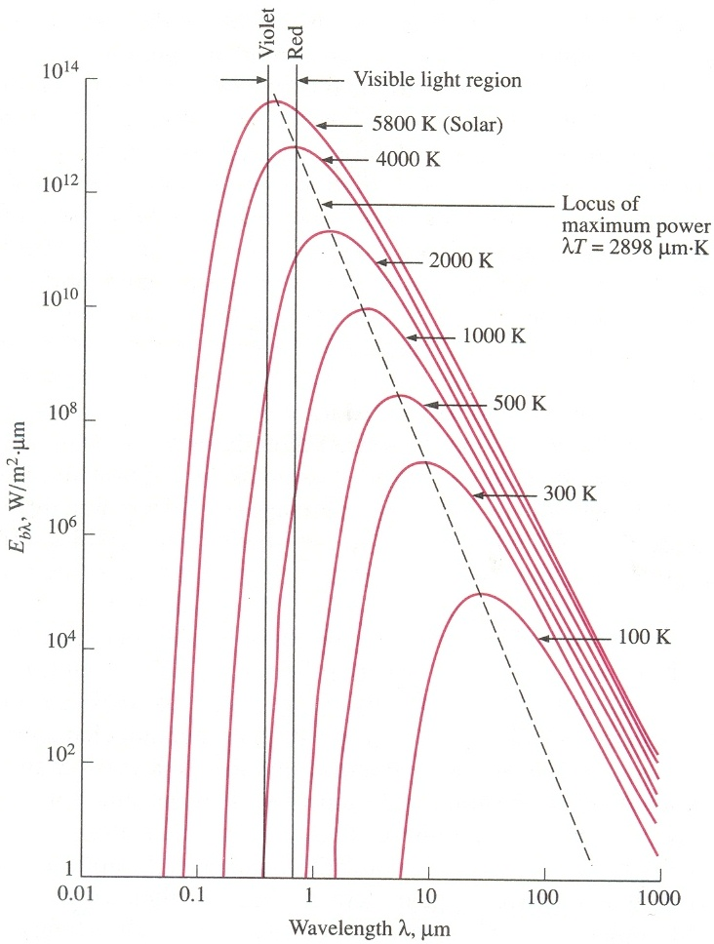
Variation of spectral black body emissive power with wavelength
Figure 30.

Slide 10
Monochromatic emissive power Cont’d
The following observations can be made from this figure:
1. The emitted radiation is a continuous function of wavelength. At any specified temperature, it increases with wavelength, reaches a peak, and then decreases with increasing wavelength.
2. At any given wavelength, the black body emissive power increases with increasing temperature.
3. As temperature increases, the curves get steeper and shift to the left to the shorter-wavelength region. Consequently, a larger fraction of the radiation is emitted at shorter wavelengths at higher temperatures.
4. The radiation emitted by the sun which is considered to be a blackbody at 5762 K (or roughly 5800 K), reaches its peak in the visible region of the spectrum. Therefore, the sun is in tune with our eyes. On the other hand surfaces at T < 800 K emit entirely in the infrared region and thus are not visible to the eye unless they reflect light coming from other surfaces.
5. As temperature increases, the peak shifts towards shorter wave1engths. The wavelength at which the peak occurs for a specified temperature is given by the Wien’s displacement law.

Slide 11
Monochromatic emissive power Cont’d
A plot of Wien’s displacement law, which is the locus of the peaks of the radiation emission curves, is given in Figure 30 as the broken line.
(3.8)
Worked Example
The temperature of the filament of an incandescent light bulb is 2500 K. Assuming the filament to be a blackbody, determine the fraction of the radiant energy emitted by the filament, which falls within the visible range. Also determine the wavelength at which the emission of radiation from the filament peaks.
Solution
The visible range of the electromagnetic spectrum extends from 0.4 μm to 0.76 μm. Noting that T = 2500 K, the blackbody radiation functions can be determined.

Slide 12
RADIATION PROPERTIES
Most materials encountered in practice, such as metal, wood and bricks are opaque to thermal radiation, and radiation is considered to be surface phenomena for such materials. That is thermal radiation is emitted or absorbed within the first few microns of the surface, and we speak of radiation properties of surfaces for opaque materials.
Some other materials, such as glass and water, allow visible radiation to penetrate to considerable depths before any significant absorption takes places. Such materials are called semitransparent. On the other hand, both glass and water, though transparent to visible radiation, are practically opaque to infrared radiation.
The radiation properties of real surfaces are often described in terms of those of the blackbody, which is a perfect emitter and absorber of radiation. The most important radiation characteristics are: emissivity, absorptivity, reflectivity and transmissivity.

Slide 13
Emissivity
The emissivity of a surface is defined as the ratio of the radiation emitted by the surface to the radiation emitted by a blackbody at the same temperature..
The emissivity of a real surface generally varies with temperature, wavelength and direction;
The emissivity of a surface at a specified wavelength is called the monochromatic or spectral emissivity, .
Similarly, the emissivity in a specified direction is called directional emissivity.
Concept of grey and diffuse surfaces
The term ‘grey’ means independent on wavelength.
The term ‘diffuse’ means independent on direction.
The results may be summarized as follows:
Real surface:
Diffuse, grey surface:

Slide 14
Emissivity Cont’d
A grey surface should emit as much radiation as the real surface it represents at the same temperature. For this to be realistic, the areas under the emission curves of the real and grey surfaces must be equal. That is,
The average emissivity can then be given as

Slide 15
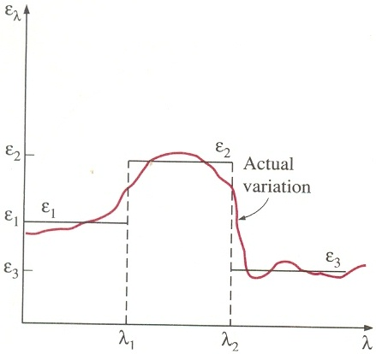
Emissivity Cont’d
As an example, consider the emissivity function below (Figure 32.).
Figure 32: Approximating the actual variation of emissivity with wavelength by a step function

Slide 16
Emissivity Cont’d
Worked Example 3.2
The monochromatic emissivity function of an opaque surface at 800 K is approximated as
Determine the average emissivity of the surface and its emissive power

Slide 17
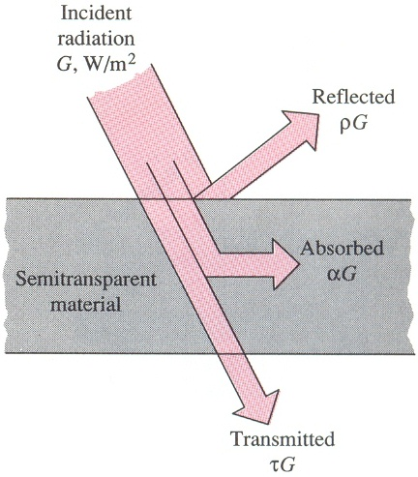
Absorptivity, Reflectivity and Transmisivity
When radiation strikes a surface, part of it is absorbed, part of it is reflected, and the remaining part, if any, is transmitted, as illustrated in Figure on the next page
The fraction of incident radiation (or irradiation) absorbed by a surface is called the absorptivity, α; the fraction reflected by the surface is called the reflectivity, ρ; and the fraction transmitted is called the transmissivity, τ

Slide 18
Different types of reflection from a surface

Slide 19
Different types of reflection cont’d
In specular (or mirror like) reflection, the angle of reflection equals the angle of incidence of the radiation beam (Fig c).
In diffuse ref1ection, radiation is reflected equally in all directions, as shown in (fig b) above. Reflection from smooth and polished surfaces approximates specular reflection, while reflection from rough surfaces approximates diffuse reflection.
In radiation analysis, a surface is said to be smooth if the height of the surface roughness is much smaller than the wavelength of the incident radiation

Slide 20
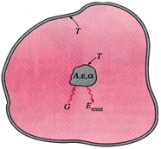
Kirchhoff’s Law
Consider a small body of
surface area A, emissivity , and
absorptivity α, at temperature T contained in a large isothermal enclosure at the same temperature, as shown in Figure 35.
Figure 35: A small body in a large isothermal enclosure

Slide 21
Worked Example 1

Slide 22
Worked Example 2

Slide 23
The Atmosphere and Solar Radiation
The sun is our primary source of energy. The energy coming from the sun, reaches us in the form of electromagnetic waves. The radiation energy emitted by the constituents of the atmosphere form the atmospheric radiation. The sun is a nearly spherical body that has a diameter, D = 1.39 x 10⁹ m and a mass of 2 x 10³⁰ kg and is located at a mean distance, L = 1.50 x 10¹¹ m from the earth (Figure 37).
It emits radiation continuously at a rate of 3.8 x 10²⁶ W. Less than a billionth of this energy strikes the earth, which is sufficient to warm the earth and to maintain life through the photosynthesis process.
The rate at which solar energy is incident on a surface normal to the sun’s rays at the outer edge of the atmosphere when the earth is at its mean distance from the sun is called the solar constant. Its value is given by G_{s} = 1353 W/m²

Slide 24
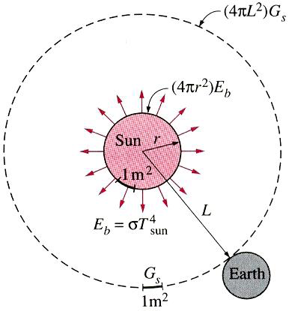
Solar radiation reaching the earth’s atmosphere
The measured value of the solar constant can be used to estimate the effective surface temperature of the sun from the requirement that

Slide 25
The Atmosphere and Solar Radiation Cont’d
The gas molecules and the suspended particles in the atmosphere emit radiation as well as absorb it. It is found convenient in radiation calculations to treat the atmosphere as a blackbody at some lower fictitious temperature that emits an equivalent amount of radiation energy. This fictitious temperature is called the effective sky temperature T_{sky}. Then, the radiation from the atmosphere to the earth's surface is expressed as
(3.34)
The value of the sky temperature depends on the atmospheric conditions. It ranges from about 230 K for cold, clear-sky conditions to about 285 K for warm, cloudy-sky conditions. The sky radiation absorbed by a surface can be expressed as:

Slide 26
The net rate of radiation heat transfer to a surface exposed to solar radiation and atmospheric radiation is determined from an energy balance
where T_{s}, is the temperature of the surface in K and is its emissivity at room temperature. A positive result for indicates a radiation heat gain by the surface and a negative result indicates a heat loss.

Slide 27
Radiation properties of surfaces are quite different for the incident and emitted radiation, and the surfaces cannot be assumed to be grey.
Surfaces that are intended to collect solar energy, such as the absorber surfaces of solar collectors, are desired to have high absorptivity and low emissivity values to maximise the absorption of solar radiation and minimise the emission of radiation. On the other hand, surfaces that are intended to remain cool under the sun, such as the outer surfaces of fuel tanks and refrigerator trucks, are designed to have just the opposite properties. Surfaces are kept cool by simply painting them white
Materials such as glass and water are semitransparent to short wavelength (0.3μm to 3μm) radiation but opaque to longer wavelength (heat) radiation. This property makes it desirable in using glass as the cover plate material for solar collector application.

Slide 28
UNIT4 -VIEW FACTORS AND RADIATION EXCHANGE BETWEEN SURFaces
Introduction
In this unit, we shall explain how view factors are computed and evaluate view factors for different configurations and understand view factor algebra. We shall apply the radiosity method for the solution of radiant heat transfer among diffuse, grey surfaces in an enclosure.
Unit content
Session 1-4: The View Factor
1-4.1: Determination of view factors
1-4.2: View Factor relations and charts
1-4.3: View factors between infinitely long surfaces
Session 2-4: Radiation Exchange between surfaces
2-4.1: The Concept of Radiosity
2-4.2: Radiation heat transfer in two surface enclosures
2-4.3: Radiation shields
2-4.4: Radiation Exchange in three or more surface enclosures

Slide 29
THE VIEW FACTOR

Slide 34
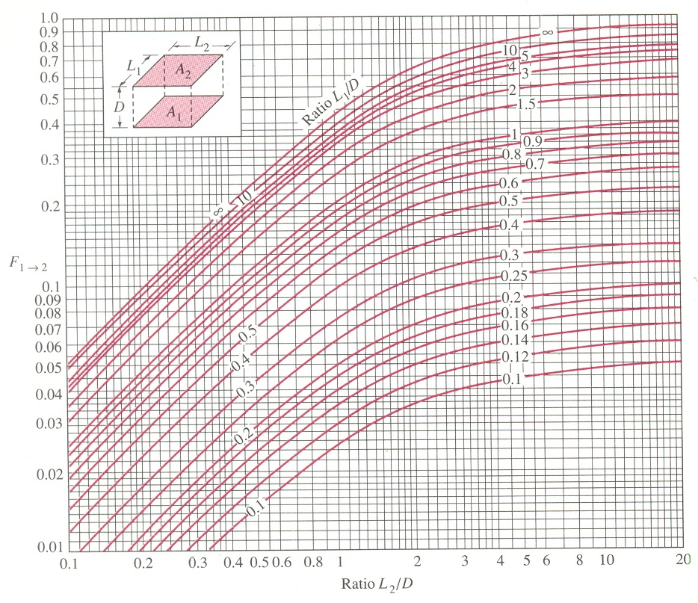
View factor between two aligned parallel rectangles of equal size

Slide 36
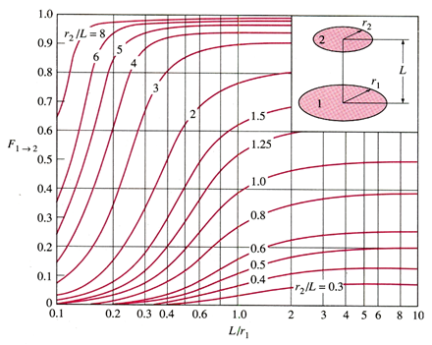
View factor between two coaxial parallel disks

Slide 37
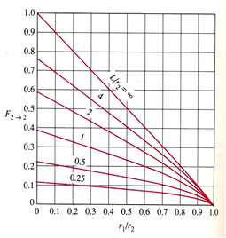
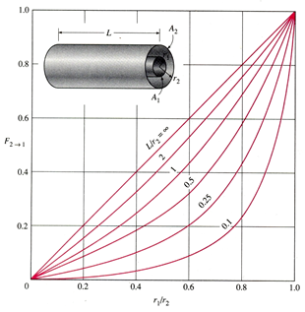
View factors for two concentric cylinders of finite length (Fig 44)
(a) outer cylinder to inner cylinder
(b) outer cylinder to itself

Slide 38
View Factor Relations and Charts

Slide 39
The Summation Rule

Slide 41
Example 3.5 (Page 123)

Slide 42
Solution
The outer surface of the smaller sphere (surface 1) and inner surface of the larger sphere (surface 2) form a two-surface enclosure. Thus, N = 2; implying that the enclosure involves N² = 2² = 4 view factors. These view factors are: F₁₁, F₁₂, F₂₁, F₂₂. In this two-surface enclosure, we need to determine only
view factor directly. The remaining three view factors can be determined by the application of the summation and reciprocity rules. But it turns out that we can determine not only one but two view factors directly in this case by a simple inspection.
F₁₁ = 0, since no radiation leaving surface 1 strikes itself and F₁₂ = 1, since all radiation leaving surface 1 strikes surface 2. The view factor F₂₁ is determined by applying the reciprocity rule to surfaces 1 and 2.

Slide 44
The Superposition Rule

Slide 46
Example 3.6: Fraction of radiation leaving an opening (page 125)

Slide 47
Solution

Slide 49
The Symmetry Rule

Slide 50
Example 3.7: View factors associated with a Tetragon

Slide 51
Solution

Slide 52
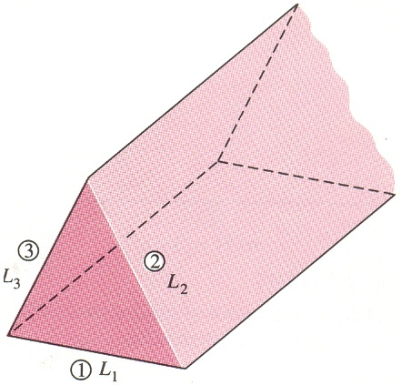
Example 3.8: View factors associated with a long triangular duct
Determine the view factor from any one side to any other side of the infinitely long triangular duct whose cross-section is given in Figure 52
Fig 52. Schematic diagram for worked example 3.8

Slide 53
Solution
Assumption: The surfaces are diffuse emitters and reflectors.
Analysis: The widths of the sides of the triangular cross-section of the duct are L₁, L₂, and L₃, and the surface areas corresponding to them are A₁, A₂, and A₃, respectively. Since the duct is infinitely long, the fraction of radiation leaving any surface that escapes through the ends of the duct is negligible. Therefore, the infinitely long duct can be considered to be a three-sided enclosure, N = 3.
This enclosure involves N² = 3² = 9 view factors, and there is the need to determine
of these view factors directly.
All 3 can be determined by inspection as since all three surfaces are flat. The remaining six view factors can be determined by the application of the summation and reciprocity rules.

Slide 54
Solution
Applying the summation rule to each of the three surfaces gives:
Knowing that F₁₁ = F₂₂ = F₃₃ = 0 and multiplying the first equation by A₁, the second by A₂, and the third by A₃ gives
Finally, applying the three reciprocity rules A₁F₁₂ = A₂F₂₁, A₁F₁₃ = A₃F₃₁, and A₂F₂₃ = A₃F₃₂ gives

Slide 55
This is a set of three algebraic equations with three unknowns, which can be solved to obtain
Note that the areas of the side surfaces have been replaced by their corresponding widths since A = Ls and the length s can be factored out and cancelled.
The result obtained can be generalised as follows: the view factor from a surface of a very long triangular duct to another surface is equal to the sum of the widths of these two surfaces minus the width of the third surface, divided by twice the width of the first surface.

Slide 56
View Factors between Infinitely long surfaces: The Crossed-Strings Method
Many practical problems involve geometries of constant cross-section such as channels and ducts that are very long in one direction relative to the other directions.
Such geometries can conveniently be considered to be two-dimensional, since any radiation interaction through their end surfaces will be negligible.
They can therefore be modeled as being infinitely long and the view factor between their surfaces can be determined by the cross-strings method developed by H.C. Hottel. The surfaces of the geometry do not need to be flat; they can be convex, concave, or any irregular shape

Slide 57
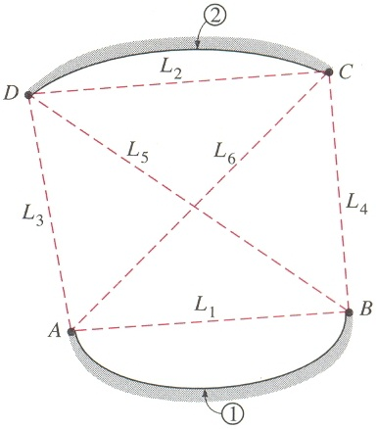
Determination of the view factor F₁₂ by the application of the crossed-strings method
Fig 53
To determine the view factor F₁₂, between surfaces 1 and 2 there is first the need to identify the endpoints of the surfaces (the points A, B, C and D) and connect them to each other with tightly stretched strings, which are indicated by dashed lines. F₁₂ can be expressed in terms of the lengths of these stretched strings, which are straight lines as
(4.9)

Slide 58
Hottel’s cross-string method can be expressed verbally as
The crossed-strings method is applicable even when the surfaces considered share a common edge, as in a triangle. In such cases, the common edge can be treated as an imaginary string of zero length. The method can also be applied to surfaces that are partially blocked by other surfaces by allowing the strings to bend around the blocking surfaces.

Slide 59
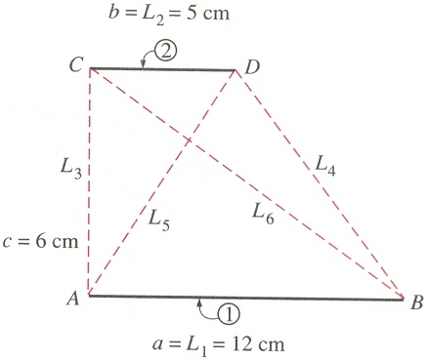
Example 3.9: The Crossed-Strings Method for View Factors
Two infinitely long parallel plates of widths a = 12 cm and b = 5 cm are located a distance c = 6 cm apart, as shown in Figure 54. (a) Determine the view factor F₁₂ from surface 1 to surface 2 using the crossed-strings method. (b) Derive the crossed-strings formula by forming triangles on the given geometry and using equation 4.8 for view factors between the sides of triangles.
Fig 54

Slide 60
Solution
Assumption: The surfaces are diffuse emitters and reflectors
Analysis: (a) First the endpoints of both surfaces are labelled and straight dashed lines are drawn between the points as shown in the figure. The crossed and uncrossed strings are identified after which the crossed-strings method is applied to determine the view factor F₁₂.
Where
substituting
,

Slide 61
(b) The geometry is infinitely long in the direction perpendicular to the plane of the paper, and thus the two plates (surfaces 1 and 2) and the two openings (imaginary surfaces 3 and 4) form a four-surface enclosure. Applying the summation rule to surface 1 yields:
F₁₁ + F₁₂ + F₁₃ + F₁₄ = 1
But F₁₁ = 0 since it is a flat surface. Therefore,
F₁₂ = 1 – F₁₃ – F₁₄
Where the view factors F₁₃ and F₁₄ can be determined by considering the triangles ABC and ABD, respectively, and applying Equation 4.8 for view factors between the sides of triangles:
.

Slide 62
Substituting,
This is also some kind of a proof of the crossed-strings method for the case of two infinitely long plain parallel surfaces.
See pages 133-137 for more examples on the determination of view factors

Slide 63
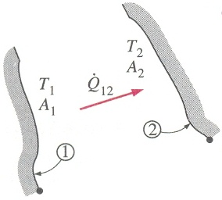
RADIATION EXCHANGE BETWEEN SURFACES
Black Surface
Consider two black surfaces of arbitrary shape maintained at uniform and constant temperatures T₁ and T₂ as shown in Figure 55.
Figure 55: Radiation Exchange between two black surfaces
The net rate of heat transfer by radiation from 1 to 2 may be determined by noting that for a black surface, any radiation striking it is completely absorbed. Using the concept of view factors already introduced, we can write the expression:

Slide 64
Mathematically, this is written as
(4.11)
Now, we recall that
(4.12)
(4.13)
Substituting, equation (4.12 & 4.13 into 4.11), gives
(4.14)
If is found to be negative, it implies that net radiation heat transfer is from surface 2 to surface 1
For an enclosure consisting of N black surfaces maintained at fixed uniform temperature, Equation 4.11 above can be generalised to give the net radiation leaving any given surface i. The resulting expression is:

Slide 65
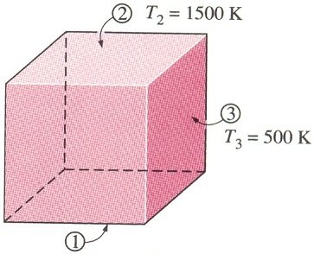
Example 3.12
The surfaces of the cubical furnace shown in Figure 56 have dimensions 5 m x 5 m x 5 m. The bottom, top and side surfaces are maintained at uniform fixed temperatures of 800 K, 1500 K and 500 K respectively. Determine
(a) The net rate of radiation heat exchange from the bottom to the side surfaces.
(b) The net rate of radiation heat exchange from the bottom to the top surface.
(c) The overall net rate of radiation heat transfer from the bottom surface
Assume that the view factor F₁₂ = 0.2
Figure 56: Heat exchange in a cubical furnace of black surfaces

Slide 66
Solution
Although the cube has six surfaces, we notice that all the sides are identical in dimensions and temperature, and could therefore be treated as one. Consequently, there are only 3 different surfaces. The surfaces are identified as 1, 2 and 3 as shown. The problem then reduces to determining Q₁₂,Q₁₃ and Q₁.
(a) The net rate of radiation heat exchange between the bottom and side surfaces is given by
To determine F₁₃, we note that F₁₁ = 0.
Using the summation rule, we have
Substituting, it follows that
(b) The rate of radiation heat exchange from surface 1 to surface 2, is obtained in a similar way,
Namely,
The negative sign indicates that net radiation heat transfer is from surface 2 to surface 1
(c) The overall net radiative heat transfer from surface 1 is obtained by summation; namely,
Thus, the bottom surface is gaining net radiation at a rate of about 925 kW

Slide 67
Grey Surfaces
In the previous section, we considered radiation interchange between black surfaces. The resulting expressions were relatively easy to develop and apply, mainly because a black surface does not reflect or transmit any radiation incident on it, but rather absorbs all.
In real life, many surfaces are encountered which cannot be considered as black body surfaces, since they may allow reflections and transmission to occur. The detailed analysis of radiation, which incorporates reflection and transmission, is rather complicated. We shall, therefore, restrict our consideration to surfaces, which can be considered as opaque, diffuse and grey. That is, the surfaces are non-transparent, they are diffuse emitters and diffuse reflectors, and their radiation properties are independent of wavelength. In addition, each surface will be assumed to be isothermal, and the radiation leaving and arriving at each surface are uniform over the surface.

Slide 68
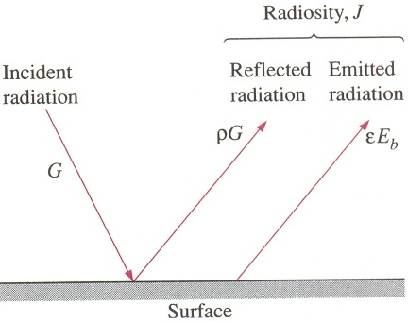
The Concept of Radiosity
In order to simplify the analysis of radiation interchange between non-black surfaces, we introduce the concept of radiosity. The radiosity of a surface, J, is defined as the total radiation energy leaving the surface per unit time and per unit area.
Figure 57: Illustrating radiation leaving a surface
For a surface i that is grey and opaque, if the incident radiation intensity is G, then the radiosity J may be written as
For an opaque grey surface, we note that

Slide 69
The expression for radiosity then becomes
(4.16)
For a black body, we not that , hence
Thus, the radiosity of a black body is equal to its emissive power.
The characteristic of a grey body is such that its surface has an “internal resistance”.
The net rate at which radiation leaves the area dA:
(4.17)
From Equation 4.16
(4.18)
Substituting Equation 4.18 into 4.17
. (4.19)
In an electrical analogy to Ohm’s Law, this equation can be arranged as:
where is the surface resistance to radiation.

Slide 70
Net Radiation Heat Transfer between Any Two Surfaces

Slide 73
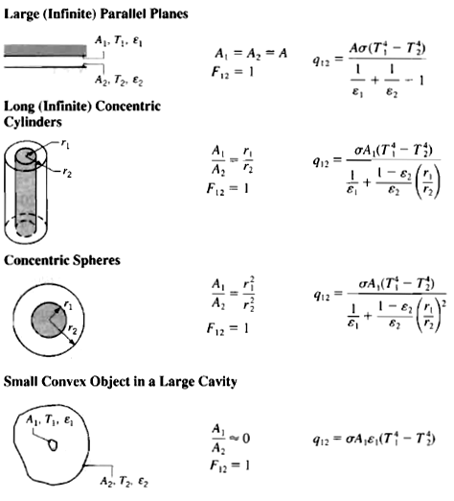
Table 3.5 Radiation exchange for common configurations

Slide 74
Radiation Heat Transfer in two surface Enclosures

Slide 75
Radiation Shields
Radiation heat transfer between two surfaces can be reduced greatly by inserting a thin, high­ reflective (low emissivity) sheet of material between the two surfaces. Such high reflective thin plates or shells are called radiation shields. Radiation shields are also used in temperature measurements of fluids to reduce the error caused by the radiation effect when the temperature sensor is exposed to surfaces that are much hotter or colder than the fluid itself. The role of the radiation shield is to reduce the rate of radiation heat transfer by placing additional resistance in the path of radiation heat flow. The lower the emissivity of the shield, the higher the resistance.

Slide 77
Radiation Shields Cont’d

Slide 78
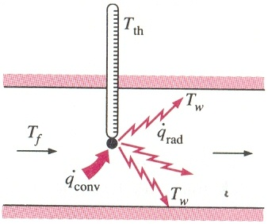
Thermocouple placed in a medium
When a thermometer or any other temperature measuring device such as a thermocouple is placed in a medium (see Figure 62), heat transfer takes place between the sensor of the thermometer and the medium by convection until the sensor reaches the temperature of the medium. When the heat transfers by convection and radiation balance each other, the sensor will indicate a temperature that falls between the fluid and the surface temperatures.

Slide 80
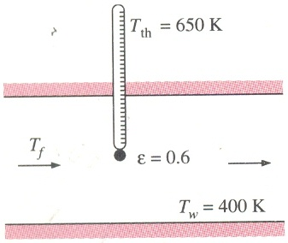
Example 3.13: Radiation effect on Temperature Measurements
A thermocouple used to measure the temperature of hot air flowing in a duct whose walls are maintained at T_{w} = 400 K shows a temperature reading of T_{th} = 650 K. Assuming the emissivity of the thermocouple junction to be ε = 0.6 and the convection heat transfer coefficient to be α_{c} = 80 W/m^{2o}C, determine the actual temperature of the air

Slide 81
Solution
Assumptions: The surfaces are opaque, diffuse and grey
Analysis: The walls of the duct are at a much lower temperature as compared to the air in it. As a result of radiation effect, the thermocouple will show a reading lower than the actual air temperature. The actual air temperature is determined using Equation 4.33 to be
Radiation effect causes a difference of 65 ºC (65 K) in temperature reading in this case.

Slide 82
Radiation Exchange in Three or More Zone Enclosures
The radiation network approach described for radiation exchange between two surfaces can readily be generalised to determine the radiation exchange among the surfaces of a three or more zone enclosure by utilising the resistances defined by Equations 4.21 and 4.25. That is the radiation resistance at surface A_{i} is given by:
And the radiation resistance across the fictitious surfaces above A_{i} and A_{j}, is given by:

Slide 85
Network representation of radiation exchange between surface i and the remaining surfaces of an enclosure

Slide 86
The Reradiating Surface
The assumption of a reradiating surface is common to many industrial applications. This idealised surface is characterised by zero net radiation transfer (q_{i} = 0).
It is closely approached by real surfaces that are well insulated on one side and for which convection effects may be neglected on the opposite (radiating side). With q_{i} = 0, if follows from Equations 3.51 and 3.54 that G_{i} = J_{i} = E_{bi}. Hence, if the radiosity of a reradiating surface is known, its temperature is readily determined.
In an enclosure, the equilibrium temperature of a reradiating surface is determined by its interaction with the other surfaces, and it is independent of the emissivity of the reradiating surface.

Slide 87
The Reradiating Surface Cont’d
A three surface enclosure with one Corresponding radiation network analysis
One surface reradiating

Slide 88
A three-surface enclosure, for which the third surface, surface R, is reradiating, is shown in the figure above with the corresponding network. Note that is represented simply as q. Surface R is presumed to be well insulated and convection effects are assumed to be negligible. Hence, with q_{R} = 0, the net radiation transfer from surface 1 must equal the net radiation transfer to surface 2. The network is a simple series-parallel arrangement, and from its analysis it is readily shown that:
.

Slide 89
Reradiating Surfaces Cont’d
Knowing that q₁ = -q₂, Equation 4.20 may be applied to surfaces 1 and 2 to determine their radiosities J₁ and J₂. Knowing J₁ and J₂, and the geometrical resistances, the radiosity of the reradiating surface J_{R} may be determined from the radiation balance:
The temperature of the reradiating surface may then be determined from the requirement that .

Slide 90
Worked Example 3.14
Consider a circular furnace that is 0.3 m long and 0.3 m in diameter. The two ends have diffuse, grey surfaces that are maintained at 400 and 500 K with emissivities of 0.4 and 0.5, respectively. The lateral surface is also diffuse and grey with an emissivity of 0.8 and a temperature of 800 K. Determine the net radiation heat transfer from each of the surfaces.
SOLUTION
Known: Circular furnace with prescribed temperatures and emissivities of the lateral and end surfaces.
Find: Net radiative heat transfer from each surface

Slide 91
Solution Cont’d
ASSUMPTIONS: (1) Surfaces are isothermal and diffuse-gray.
ANALYSIS: To calculate the net radiation heat transfer from each surface, we need to determine its radiosity. First, evaluate terms which will be required. The radiation network is the same as in Figure 65.
The view factor F₁₂ results from Figure 44 with L/r₁ = 2 and r₂/L = 0.5. The radiation balances using Eq. 4.40, omitting units for convenience, are:

Slide 92
Solution Cont’d
The radiation balances using eq.4.40(page153),and omitting units for convenience are:

Slide 93
Solution Ends
Using Eq. 4.37, the net radiation heat transfer for each surface follows:
Comments: Note that . Also, note that J₂ < J₁ despite the fact that T₂ > T₁; note the role emissivity plays in explaining this.

Slide 94
Self Assessment 2-4
1. Two large surfaces are maintained at 500 K and 1000 K respectively. Determine the rate of radiant heat exchange between the plates per unit area.
i. If they are black bodies
ii. If they are grey bodies with
2.A shield having emissivity of 0.5 is placed between the bodies at the above temperature. Determine the rate of radiant heat flow per unit area between
i. The black bodies
ii. The grey bodies with
3. Determine the temperature of the shield of the two cases in (2) above

Slide 95
Review Question
A furnace is of cylindrical shape with R = H = 2 m. The base, top, and side surfaces of the furnace are all black and are maintained at uniform temperatures of 500, 700, and 1200 K, respectively. Determine the net rate of radiation heat transfer to or from the top surface during steady operation.
.

Slide 96
Reading Assignment
Read chapter 12, Heat transfer, A practical approach by Yunus. A. Cengel, 2nd Edition.
Thank You My Students

